Slide 1
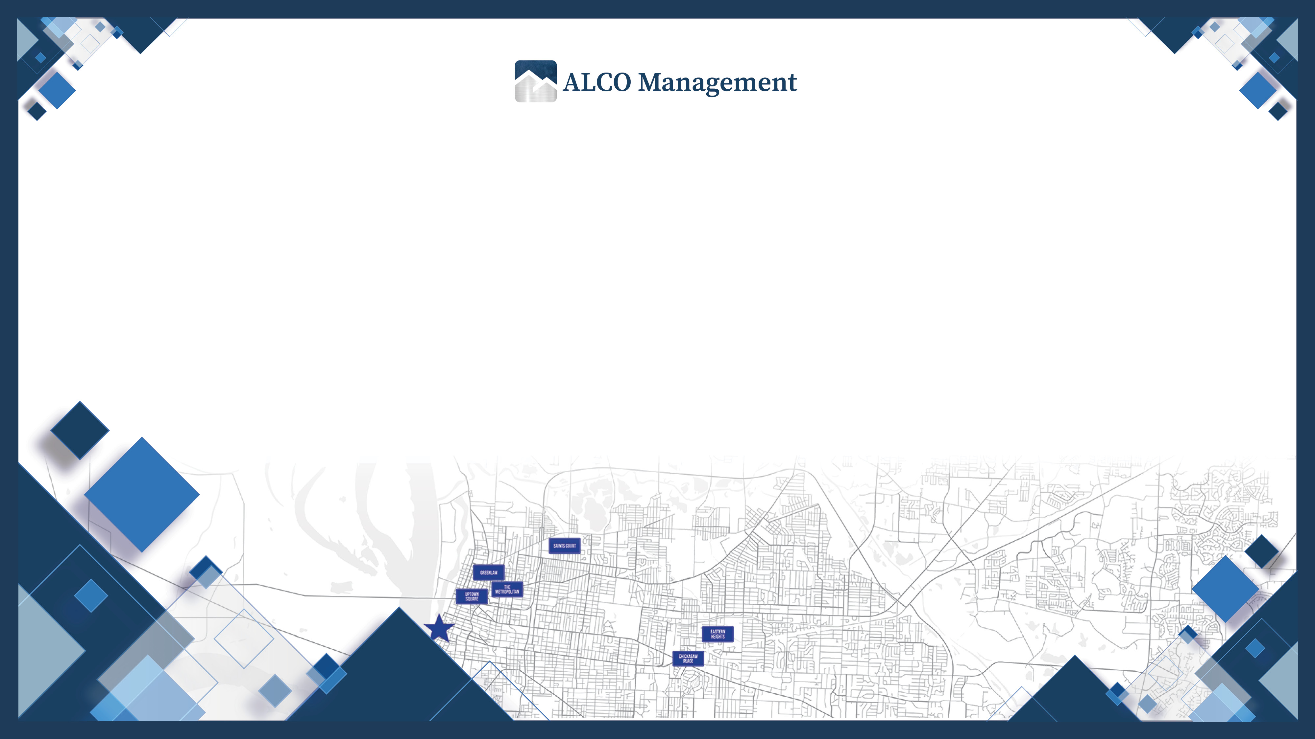
RIGHTSOURCE
SPECIAL CLAIMS PROCESS
Notes:
Welcome to the Special Claims Process Training!

Slide 2

TODAY’S AGENDA
HOW TO CREATE A SPECIAL CLAIMS TENANT IN RIGHTSOURCE
UPLOADING A SPECIAL CLAIM FOR REVIEW
REVIEWING CORRECTIONS IN RIGHTSOURCE
UPLOADING CORRECTIONS FOR SPECIAL CLAIMS
CANCELING A SPECIAL CLAIM
Notes:
In this session, we will discuss the following:
How to Create a Special Claims Tenant in RightSource
Uploading a Special Claim for Review
Reviewing Corrections in RightSource
Uploading Corrections for Special Claims
Canceling a Special Claim

Slide 3

CLAIMS MUST BE SUBMITTED
A SPECIAL PROVISION FOR SECTION 8 PROPERTIES
SECTION 8 PROPERTIES
No more than 180 Days from the date
the unit was made ready for occupancy.
Can Claim 80% of contract rent for a vacant
unit is ready for occupancy until the day the
unit is reoccupied for up to 60 Days.
Is the ability to Submit Vacancy loss claims to HUD.
Notes:
A special provision for Section 8 properties is the ability to submit vacancy loss claims to HUD.
Section 8 properties can claim 80% of contract rent for a vacant unit starting the day the unit is ready for occupancy until the day the unit is reoccupied for up to 60 days.
Claims must be submitted no more than 180 days from the date the unit was made ready for occupancy.

Slide 4

WHAT UNITS ARE
ELIGIBLE FOR CLAIMS?
ELIGIBLE
Former resident was a Subsidized Household.
Household Terminated for Failure to Comply.
The unit is Decent, Safe, and Sanitary.
The owner has done All Feasible Actions to fill vacancy.
The owner has “Worked” the waiting list.
NOT ELIGIBLE
Former resident was a Market Household due to Income Increasing.
Unit was occupied by Security Personnel or a Police Officer.

Slide 5

1
How to create
SPECIAL CLAIMS
TENANT IN RIGHTSOURCE
Notes:
Meet Valerie (CM). Valerie has a vacant unit at her property and is working to get the unit occupied. Because Valerie supports a property that has the Section 8 program, she can submit a vacancy loss claim for the unit that is unoccupied.
This will ensure that her property still recognizes revenue for the vacant unit until it is occupied.

Slide 6


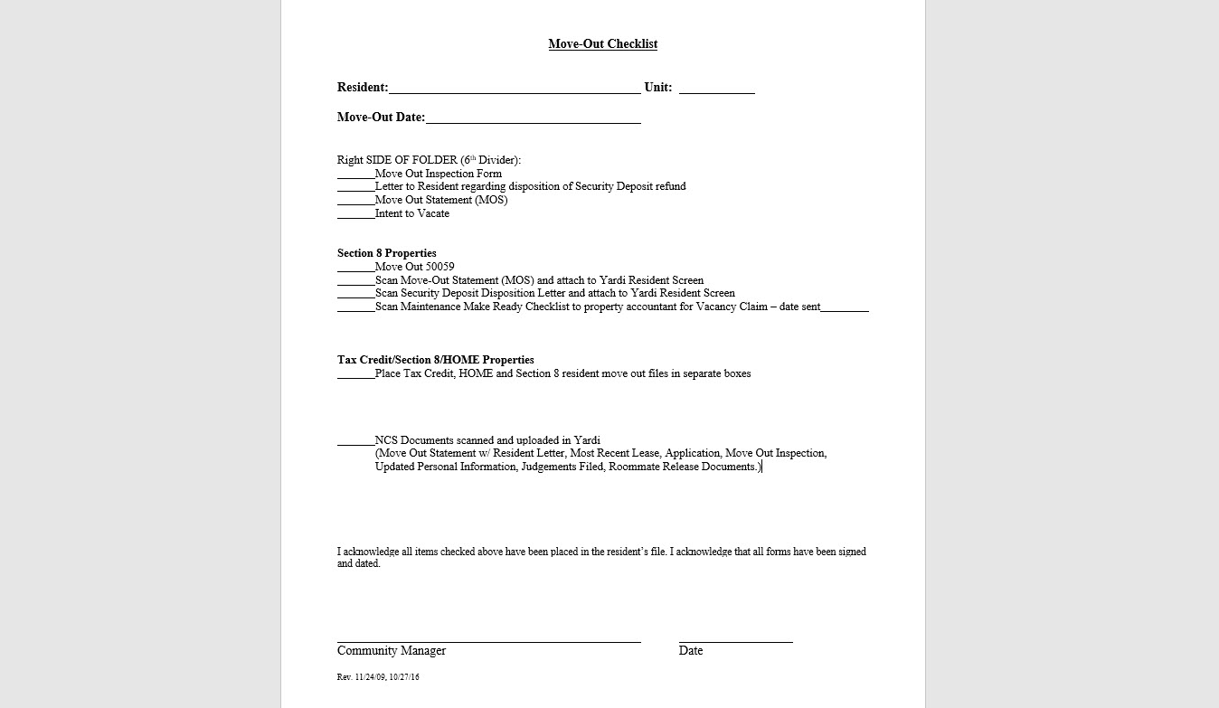
VALERIE
“Manager”
Notes:
Picture of Move-Out Checklist
The first thing that Valerie will do is complete the Move-Out Checklist located in Yardi Voyager and ensure that all corresponding documents are available to be uploaded into RightSource.

Slide 7



DOCUMENTS FOR
SPECIAL CLAIMS?
CA Checklist
Copy of the Signed MI (Move In) 50059
Security Deposit
Examples:
Copy of the original lease
(Front page, Deposit Page, Signature Page)
Copy of the Resident’s Ledger Card
Copy of the Receipt
Check Image
(With Bank Account Information Redacted)
Security Deposit Disposition
Examples:
Pre-Inspect Move Out Letter
Final Resident Ledger
Security Disposition Notice
Make Ready Checklist
Marketing Efforts (If there is No Wait List)
Notes:
(documents that the Voucher Processing team wants to file a special claim):

Slide 8
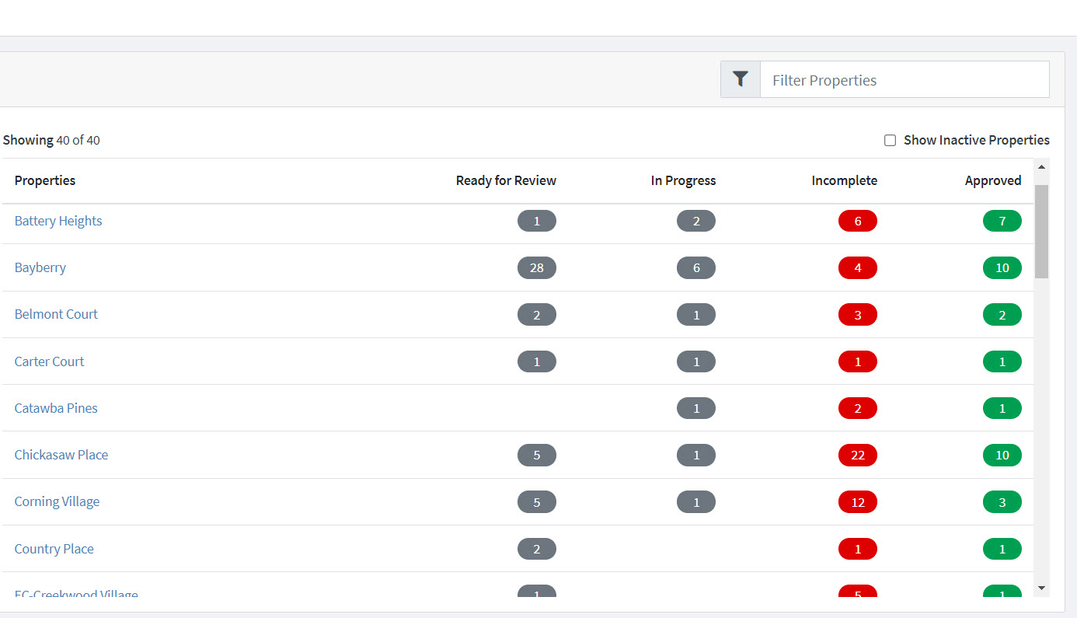

VALERIE
“Manager”
Notes:
Next, she will access RightSource from her Okta dashboard.
The Properties screen will appear. Valerie will select her property by clicking the property’s name.

Slide 9
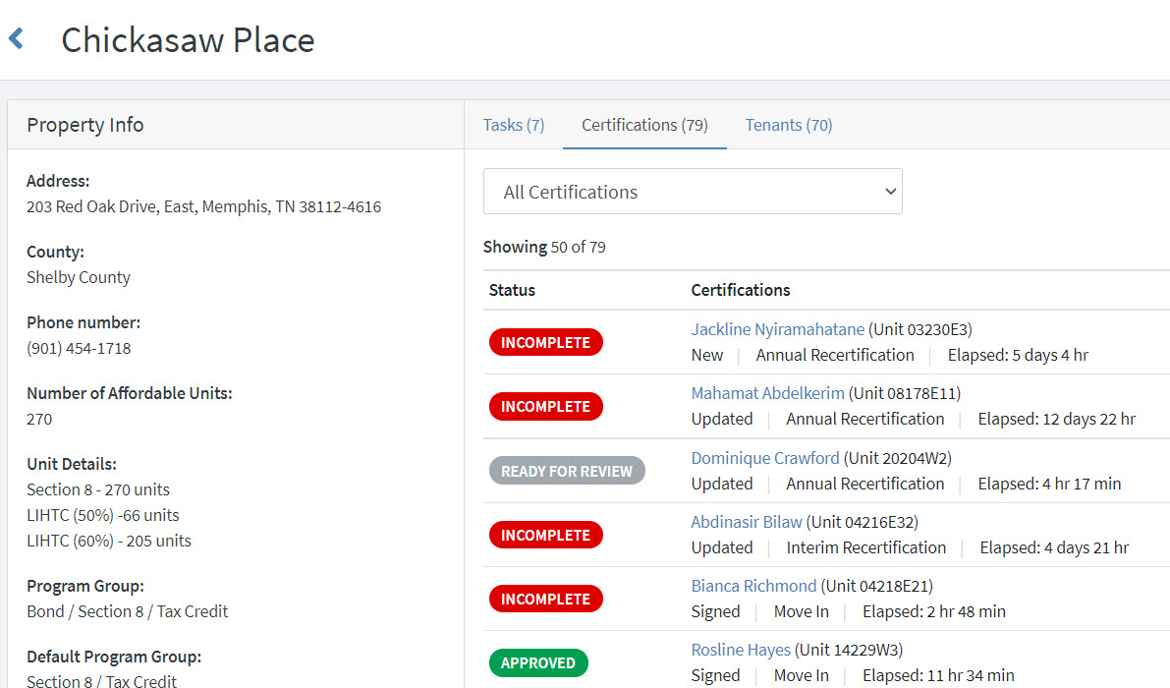
VALERIE
“Manager”
Notes:
Valerie will be able to see all files that have been submitted to RightSource for her property.
Valerie will click Tenants, located above the certifications that appear for her property.

Slide 10
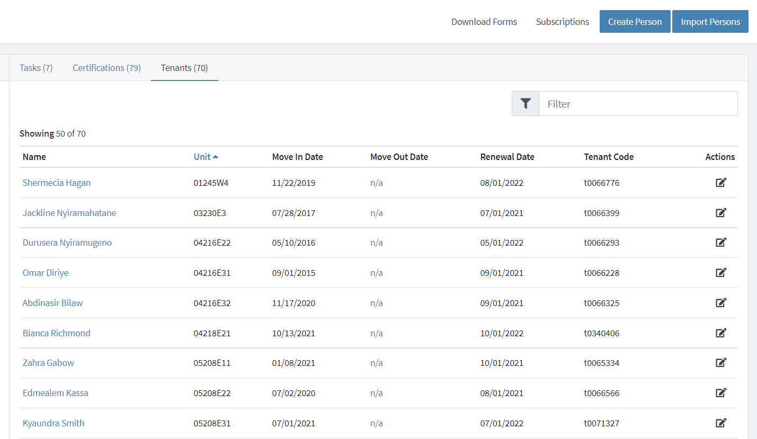
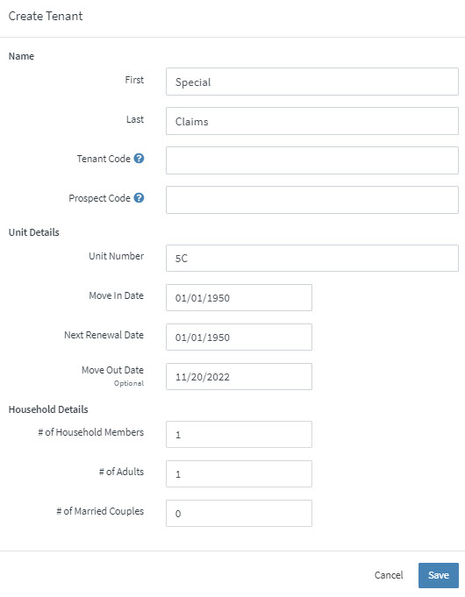
VALERIE
“Manager”
Notes:
To initiate the vacancy loss special claim, Valerie will click the Create Person button (located in the top, right corner) and enter the following information:
First – Enter “Special”
Last – Enter “Claims”
Unit Number – Enter the unit number that the vacancy loss claim is being submitted
Move-In Date – Enter “1/1/1950”
Next Renewal Date – Enter “1/1/1950”
Move-Out Date – Enter the actual move-out date of the previous resident
Click Save.

Slide 11
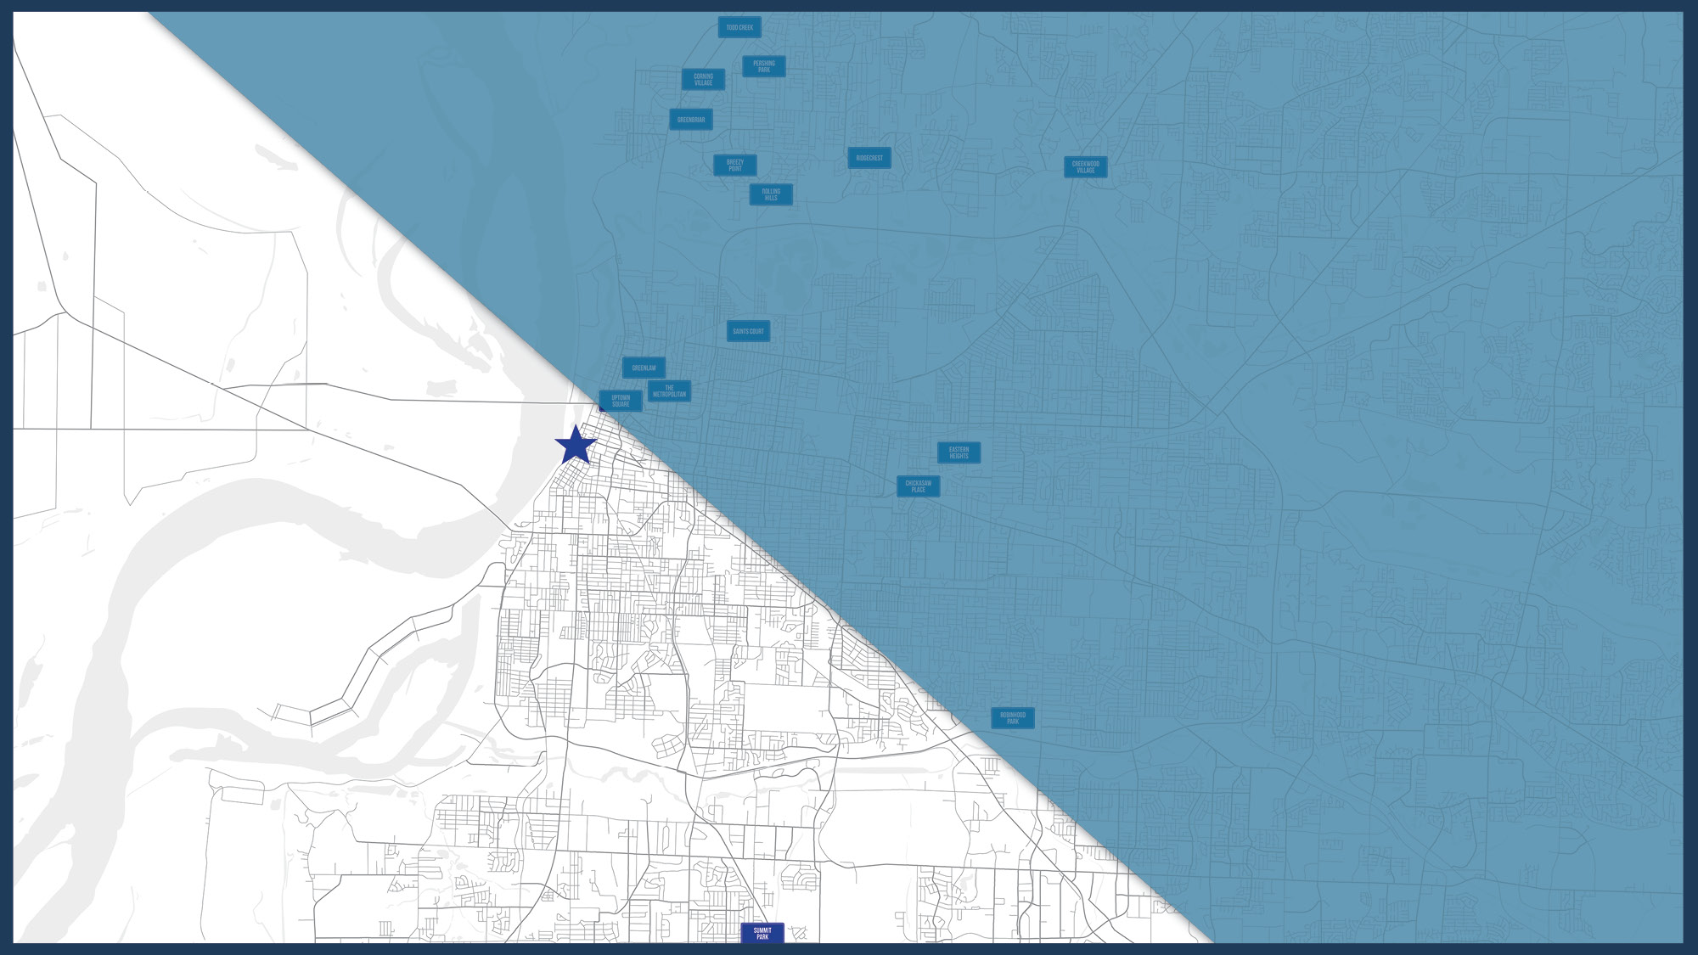
2
Uploading
SPECIAL CLAIMS
FOR REVIEW
Notes:
Now that Valerie has created a Special Claims tenant for her property, she can now upload her move-out file for that unit in RightSource.

Slide 12
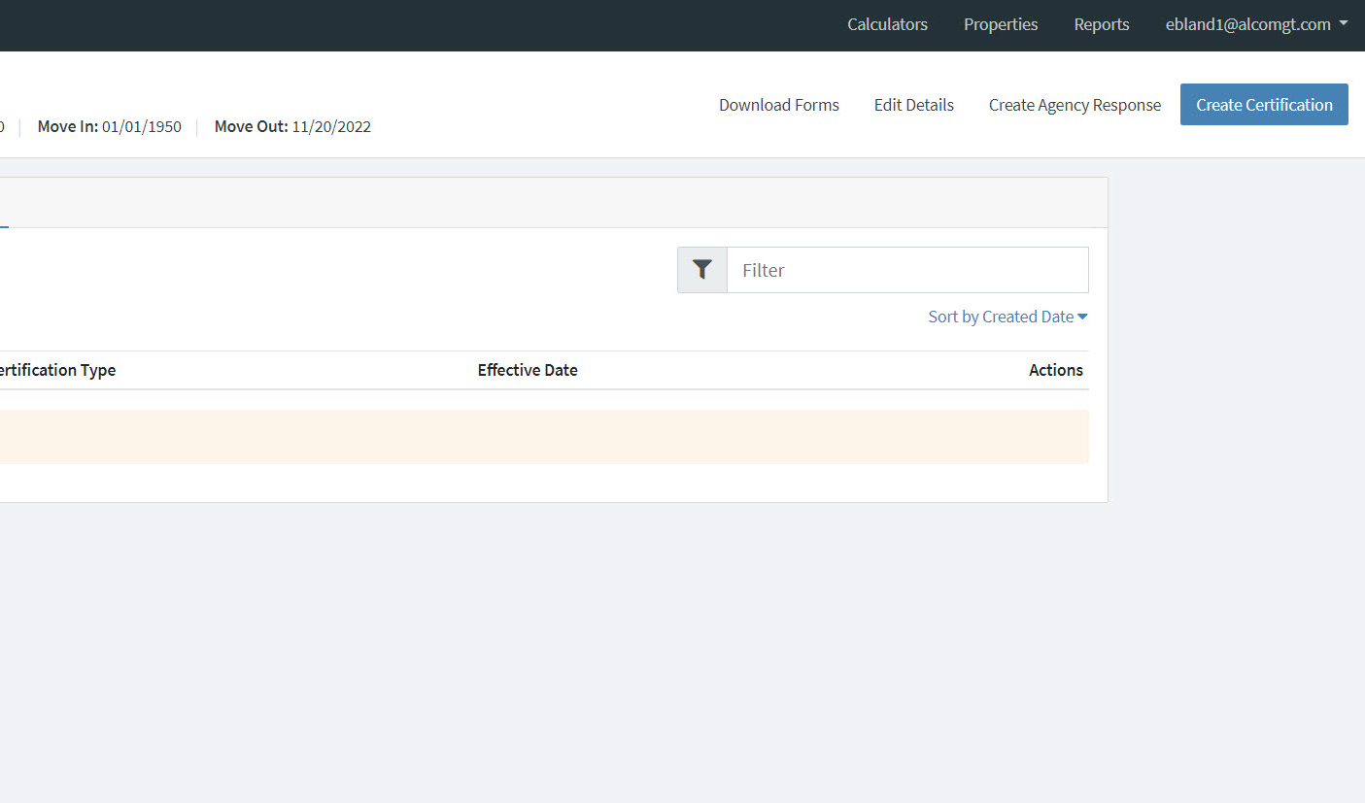
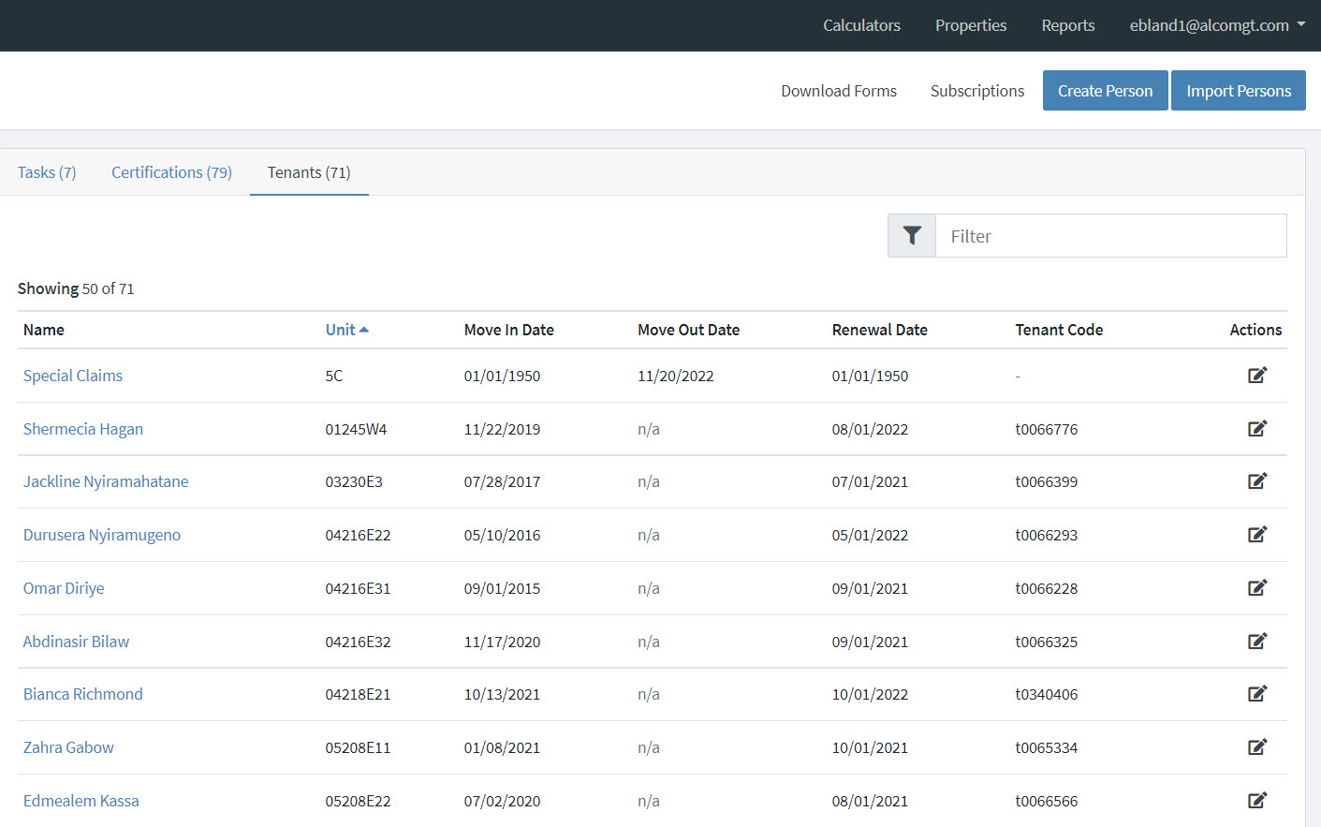
VALERIE
“Manager”
Notes:
In RightSource, Valerie will click the Tenants tab and select the Special Claims tenant that she just created.
Valerie will select Create Certification located in the upper, right corner.

Slide 13
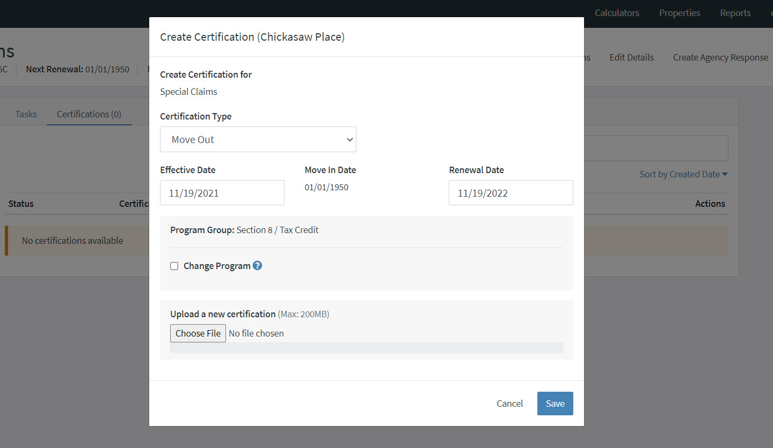
VALERIE
“Manager”
Notes:
She will enter the following information:
Certification Type – Move Out
Effective Date – Enter today’s date
Renewal Date – Enter today’s date
She will click Choose File and locate the move-out file to be uploaded. Please Note: Valerie will upload the complete move-out file and the Special Claims checklist. The Special Claims checklist can be found on the Learning Resource Documents page (RightSource _ Special Claims _ Your State) in SharePoint.
Also Note: RightSource will create the HUD Form 52671-C and HUD Form 52670-A. These forms do not need to be sent with the initial special claim upload.
Now that Valerie has uploaded the appropriate documents, she will click Save. The Special Claim will move to the Ready to Review status.

Slide 14
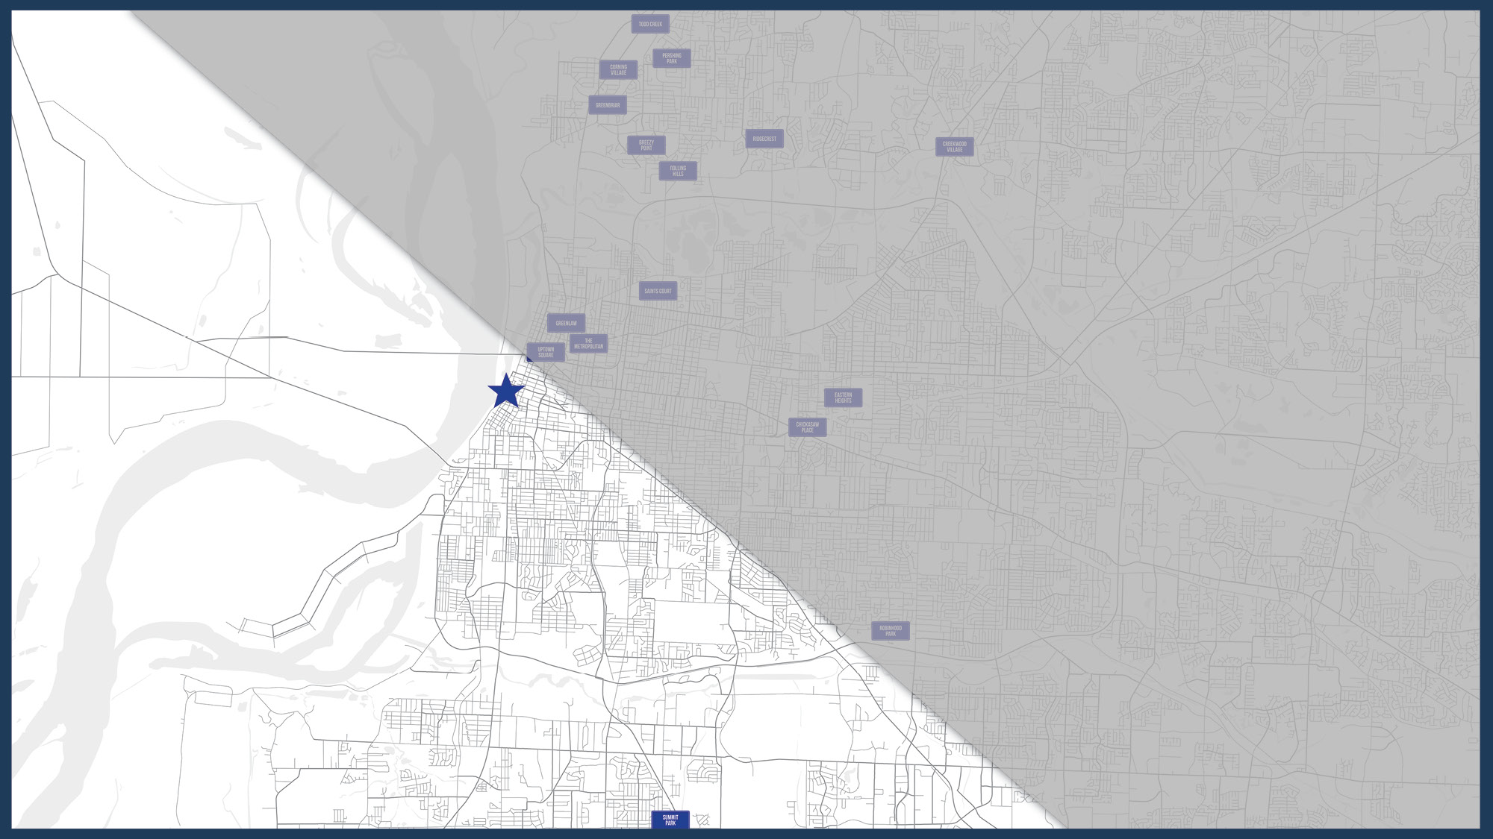
3
Reviewing
CORRECTIONS IN RIGHTSOURCE
Notes:
Valerie will be able to view the status of the special claim that she just submitted at any time.

Slide 15
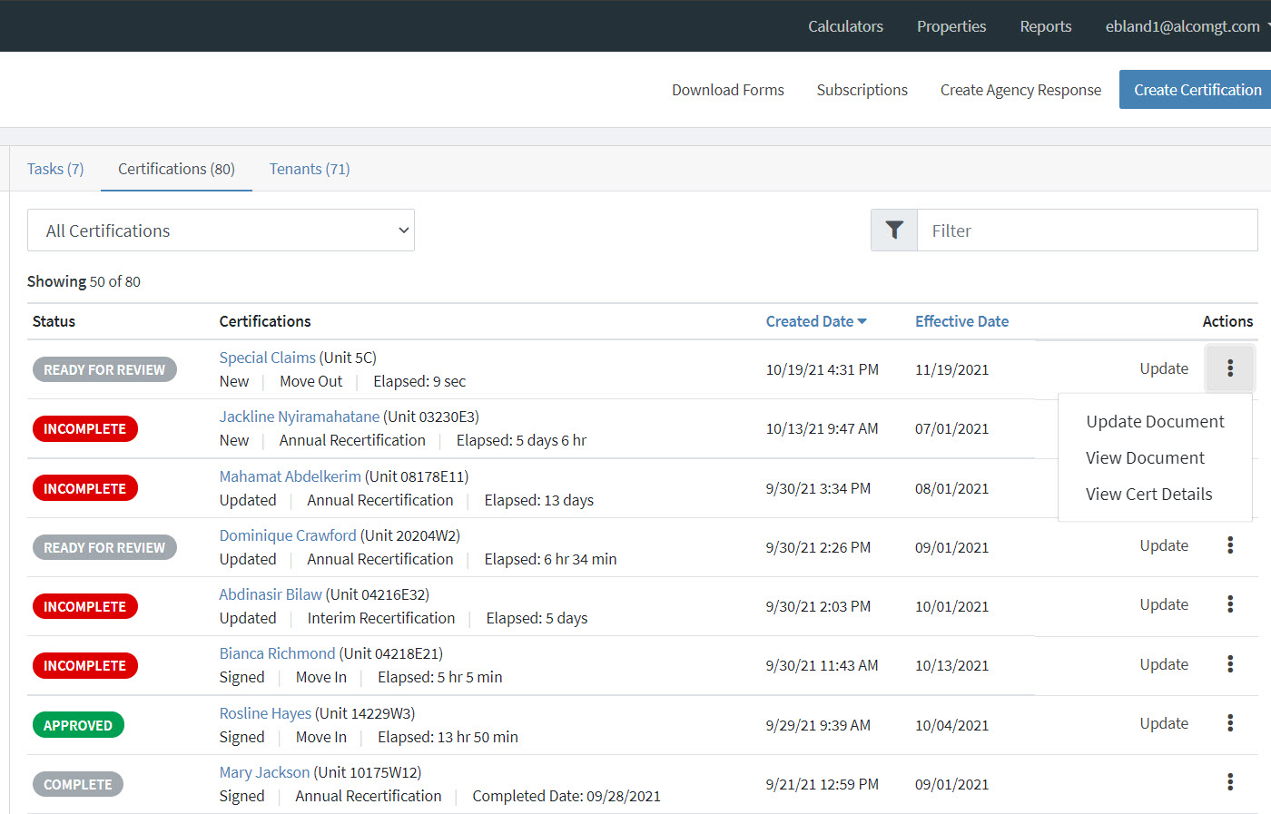
VALERIE
“Manager”
Notes:
If the status is Incomplete, Valerie can view RightSource’s findings by first selecting her property on the Properties page.
Next to the tenant named Special Claims, she will click the vertical three dots and select View Document.

Slide 16
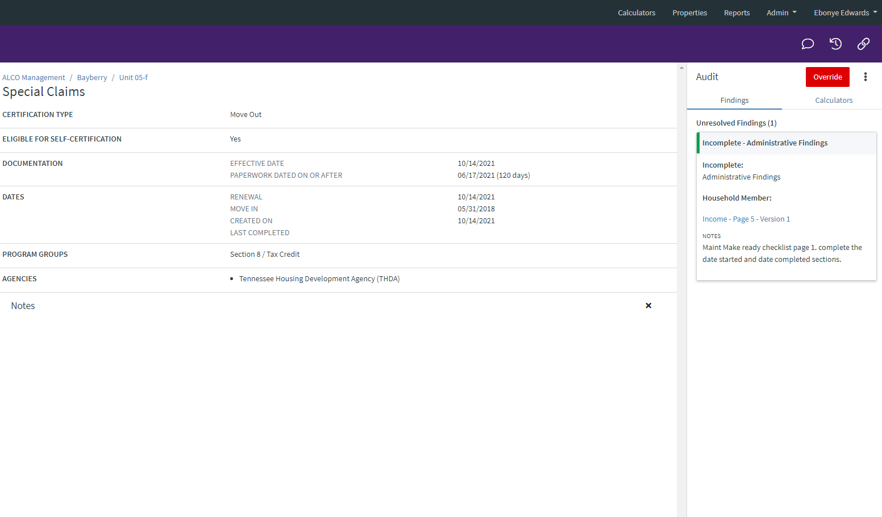
VALERIE
“Manager”
Notes:
Valerie will select each individual finding to display the finding, the finding type, and any specific notes pertaining to the finding.
If corrections are needed, Valerie will upload them to RightSource using the same steps outlined for her initial upload. Uploading new information will change the status of the special claim to Ready for Review.
Please Note: Valerie will not re-upload the entire file, only the corrections that have been outlined.

Slide 17
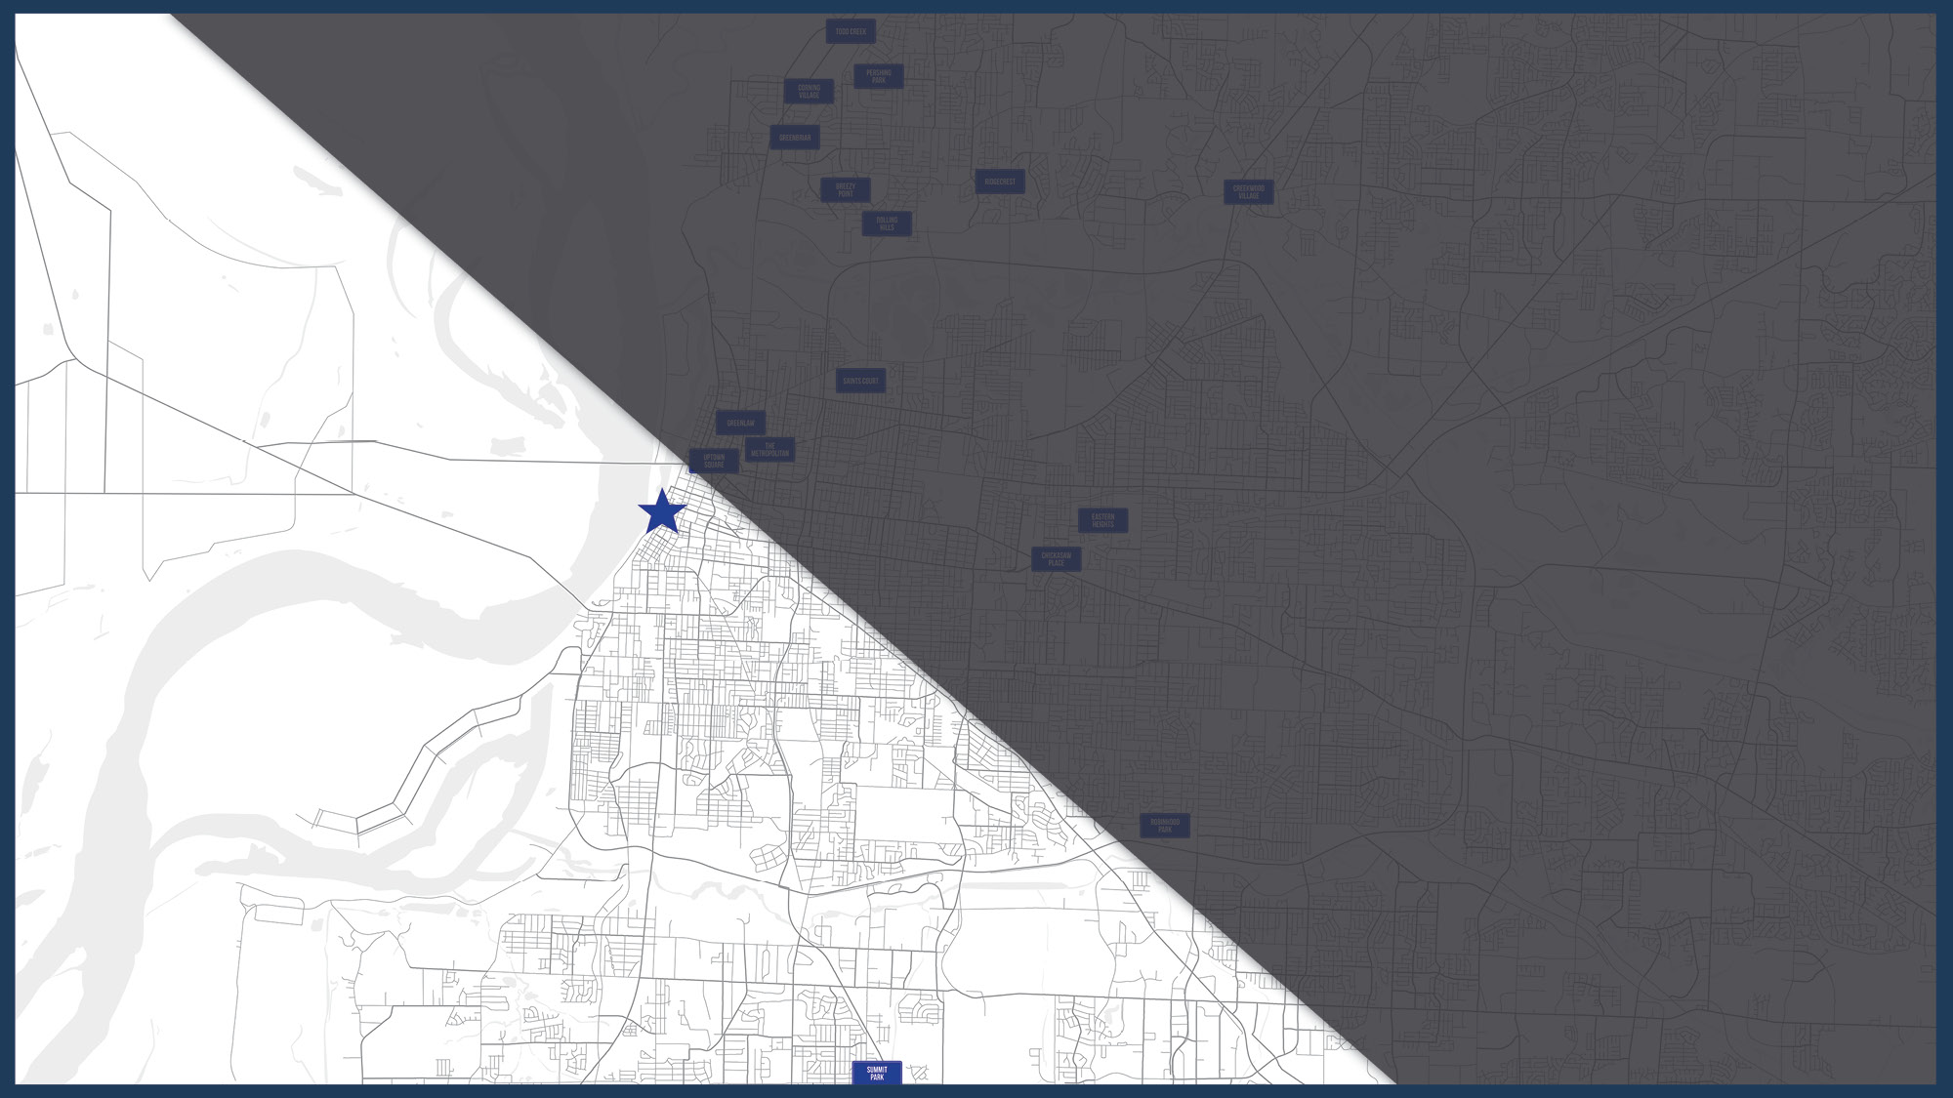
4
Uploading
SPECIAL CLAIMS
Notes:
Let’s now discuss how to upload corrections for special claims.

Slide 18
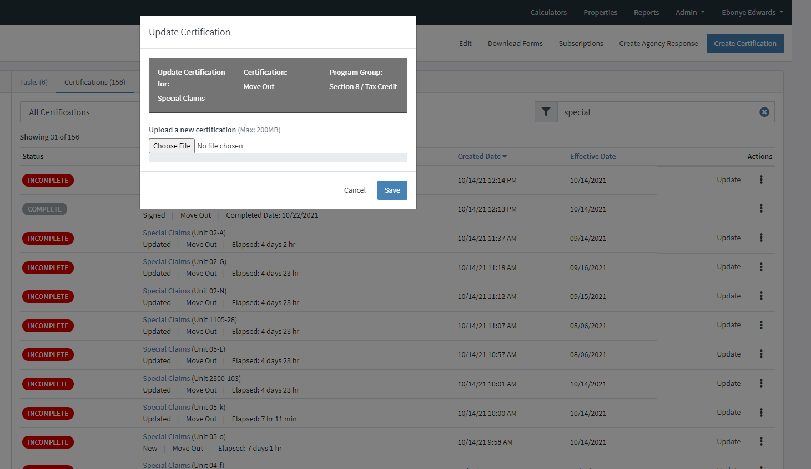
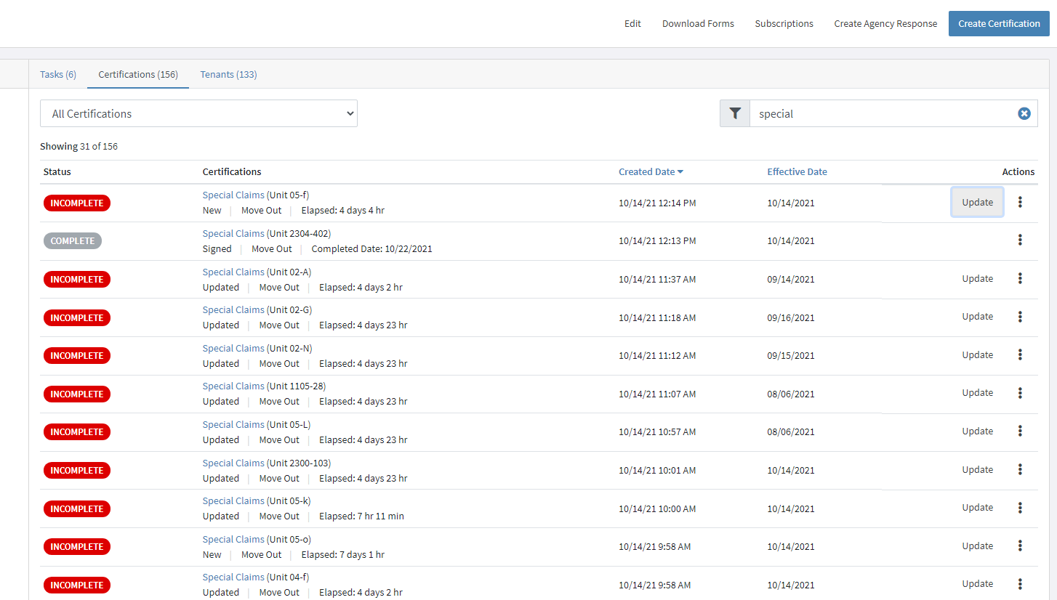
VALERIE
“Manager”
Notes:
Once a special claim has been reviewed, the claim can be updated by submitting corrections needed rather than uploading the entire file.
After Valerie clicks her property from the Property’s screen, she will locate the Special Claims tenant and click Update.
Next, Valerie will click Choose File, select the appropriate document(s), and click Save.

Slide 19

Once the special claim is approved, RightSource
will submit all required documents to the Contract Administrator or the local HUD Field Office.
When Management receives the approval letter from the Contract Administrator or the local HUD Field Office, this letter will be uploaded to the approved Special Claims file in RightSource.
RightSource will review the approval letter and enter the claim in Yardi. This will allow for the special claim to successfully make it on the next voucher.
RightSource will then mark the Special Claims file
in RightSource as “Complete” and upload the
approved documents.
Notes:
Once the special claim is approved, RightSource will submit all required documents to the Contract Administrator or the local HUD Field Office.
When Management receives the approval letter from the Contract Administrator or the local HUD Field Office, this letter will be uploaded to the approved Special Claims file in RightSource.
RightSource will review the approval letter and enter the claim in Yardi. This will allow for the special claim to successfully make it on the next voucher.
RightSource will then mark the Special Claims file in RightSource as “Complete” and upload the approved documents.

Slide 20
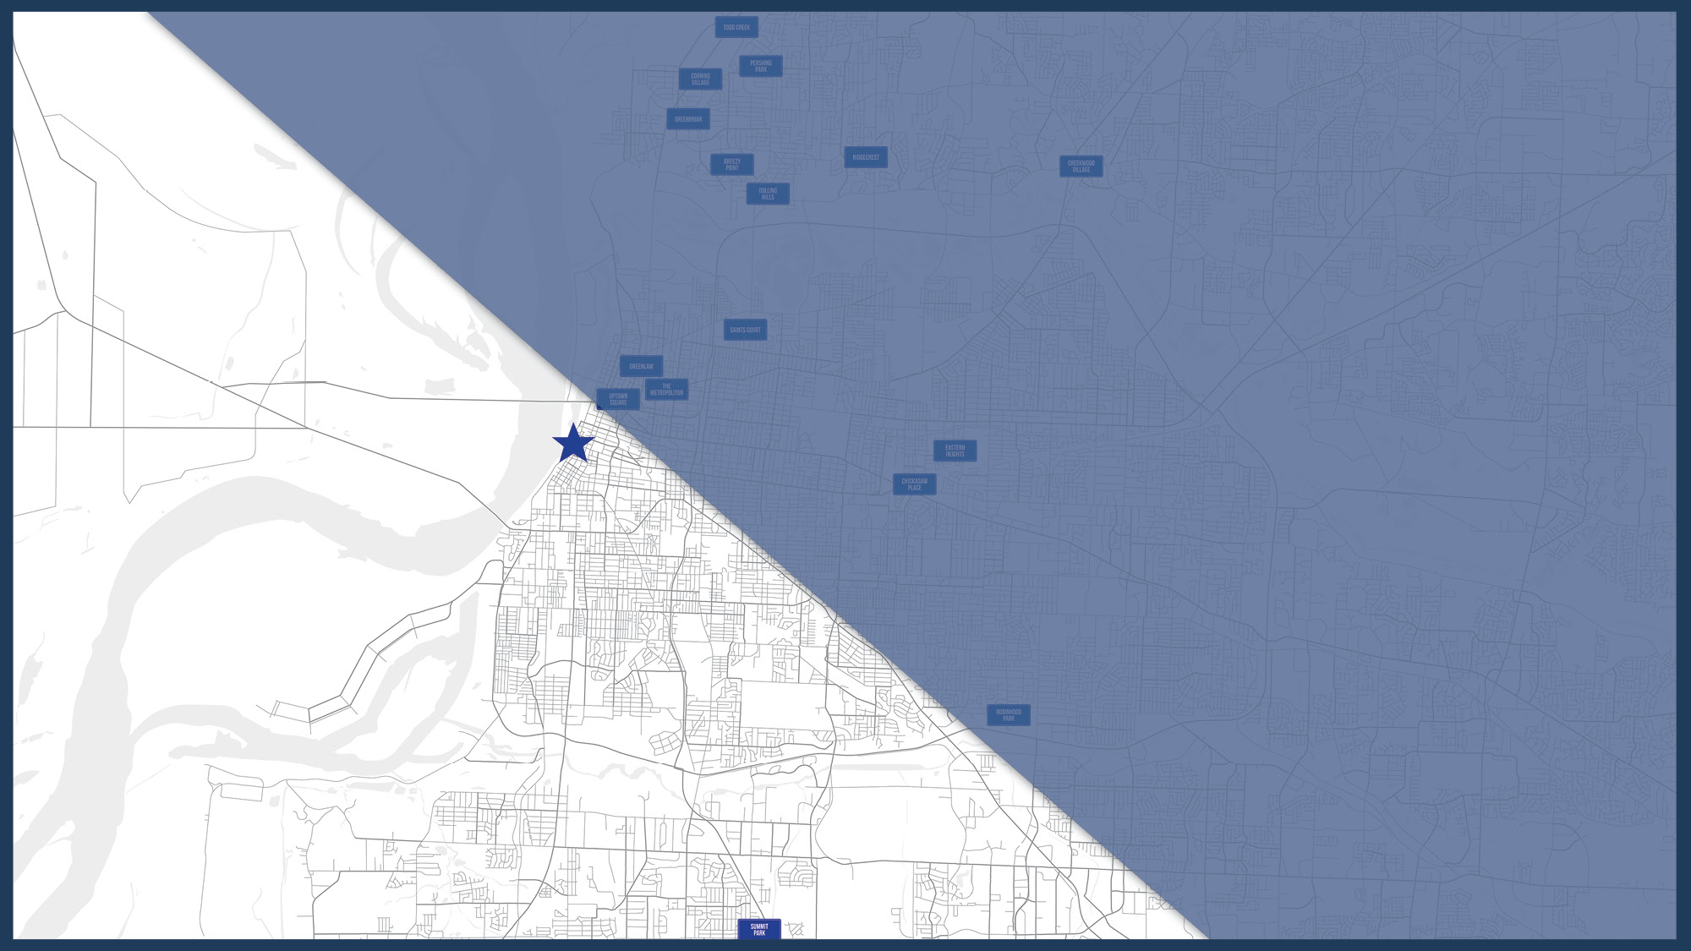
5
Cancelling
SPECIAL CLAIMS
Notes:
There are instances in which a special claim may need to be cancelled. This may happen if a special claim was uploaded incorrectly.
In this section, we will discuss how to properly cancel a special claim that may have been created in error.

Slide 21
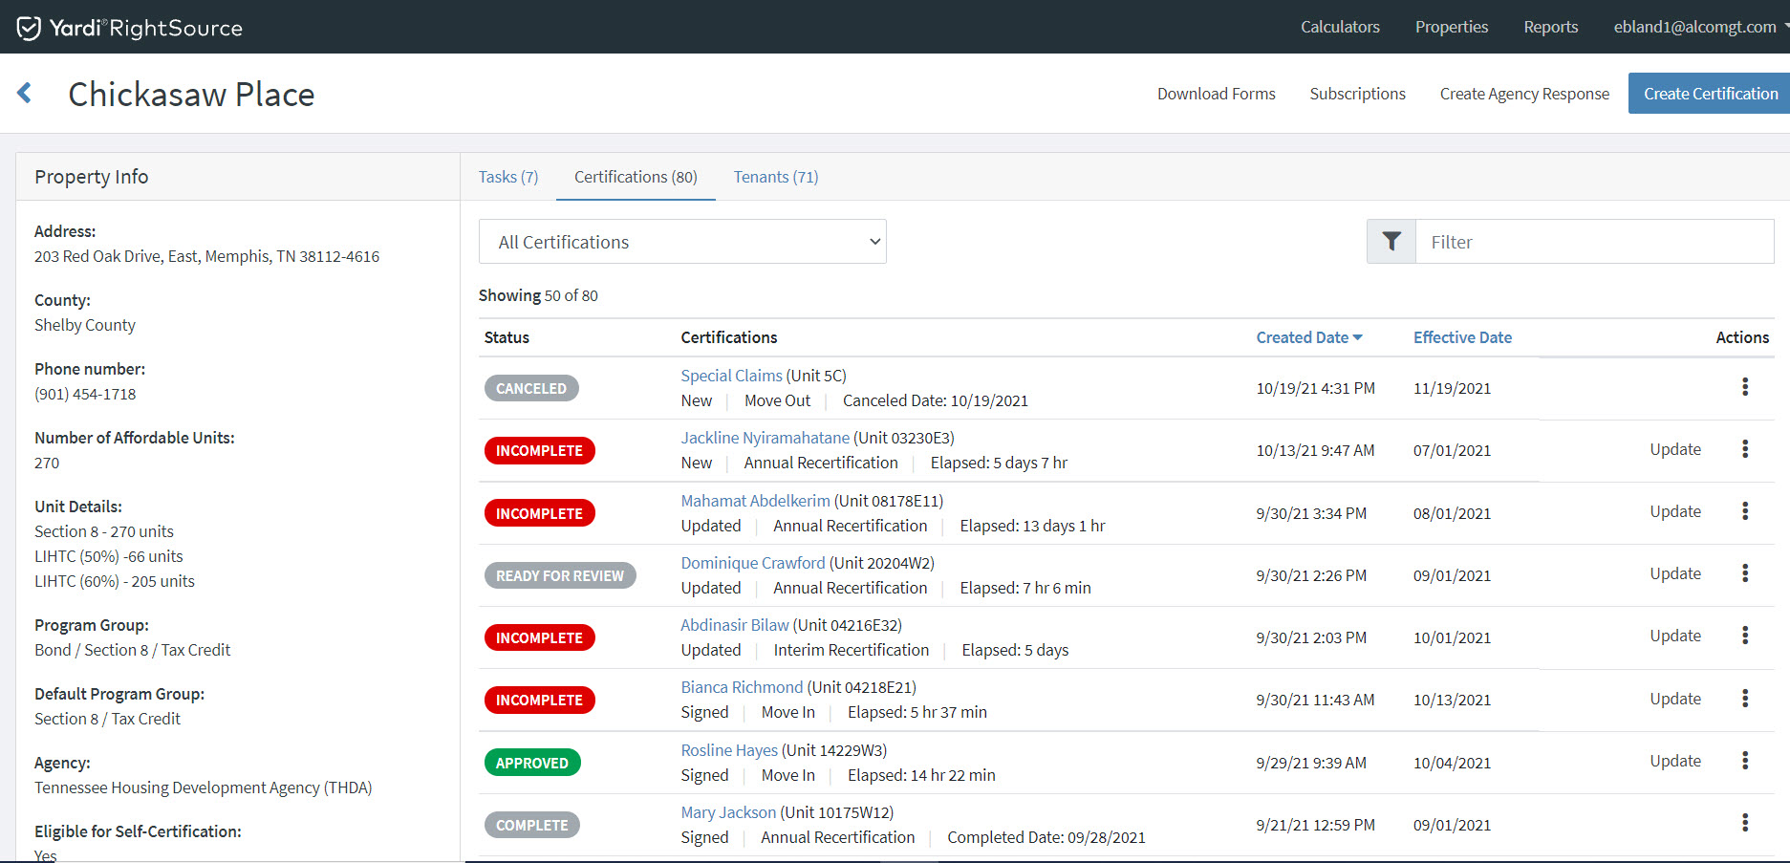
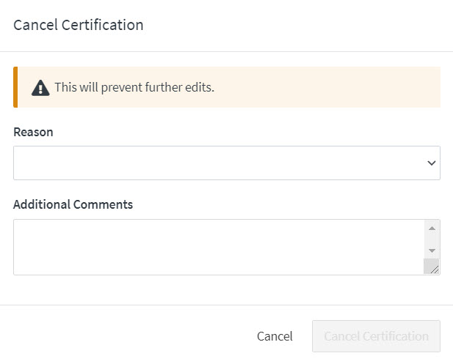

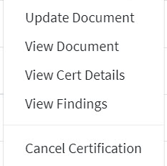

VALERIE
“Manager”
This is a test.
Notes:
Valerie will locate the Special Claim tenant that requires cancellation, click the three vertical dots and select Cancel Certification.
The Cancel Certification screen will appear.
She will select the appropriate cancellation reason from the Reason drop-down and add any additional comments regarding the reason for cancellation in the Additional Comments field.
Next, she will click Cancel Certification. The status will be updated to Canceled. This status will indicate to RightSource that no further actions are needed.
Please Note: The special claim will still appear but will show as Canceled.

Slide 22
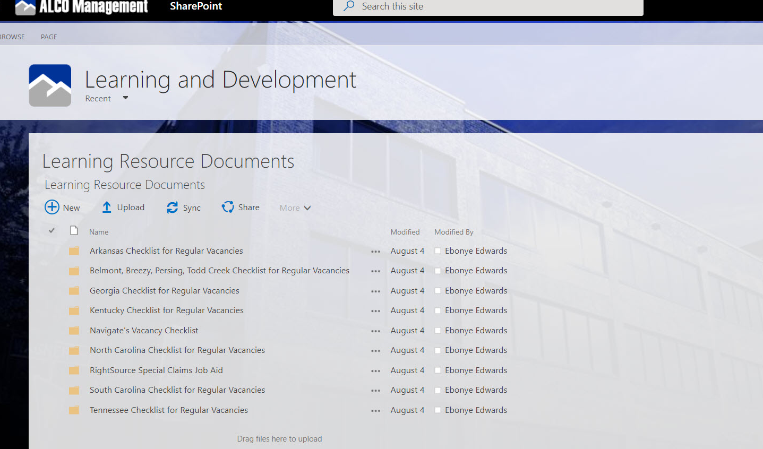
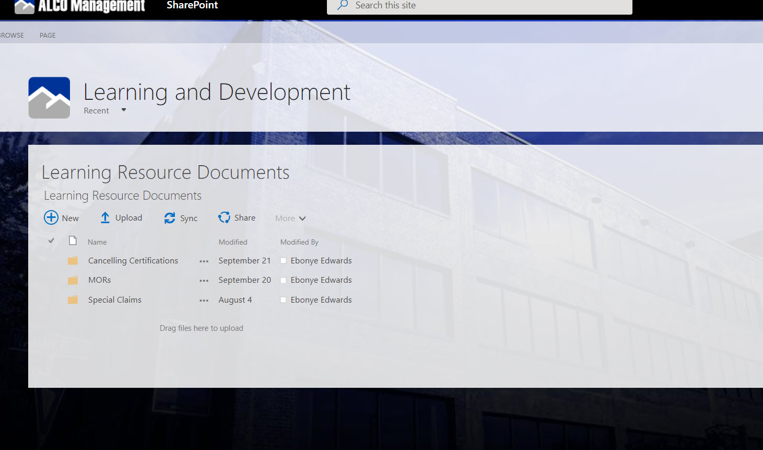
Notes:
This process is outlined in the:
RCRS_Special Claims Job Aid that is in the Learning Resource Document SharePoint page.

Slide 23
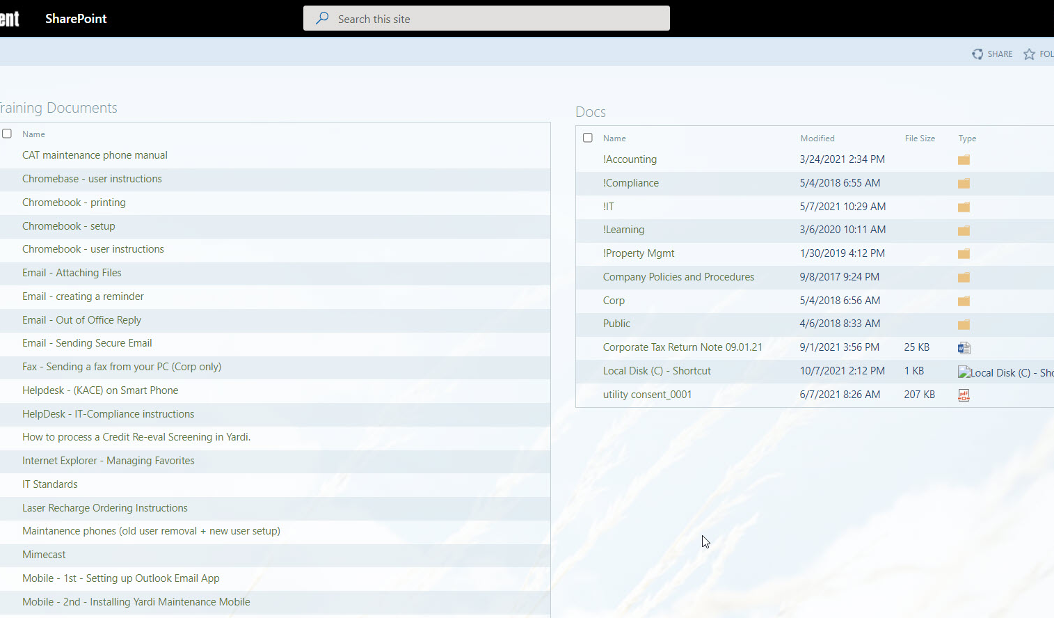
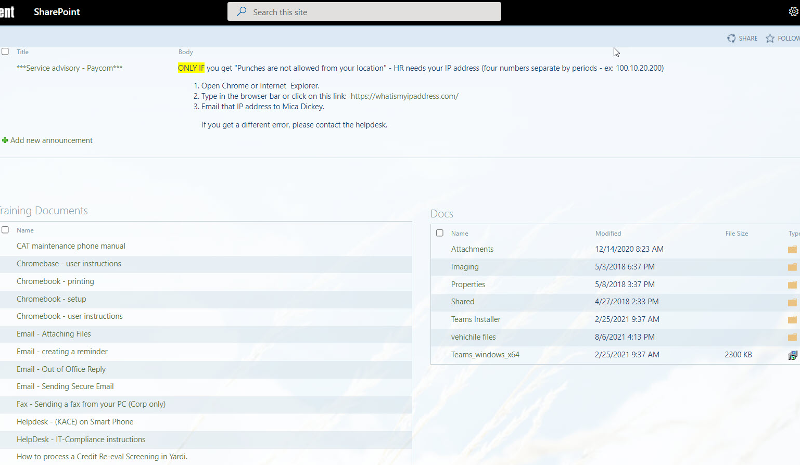
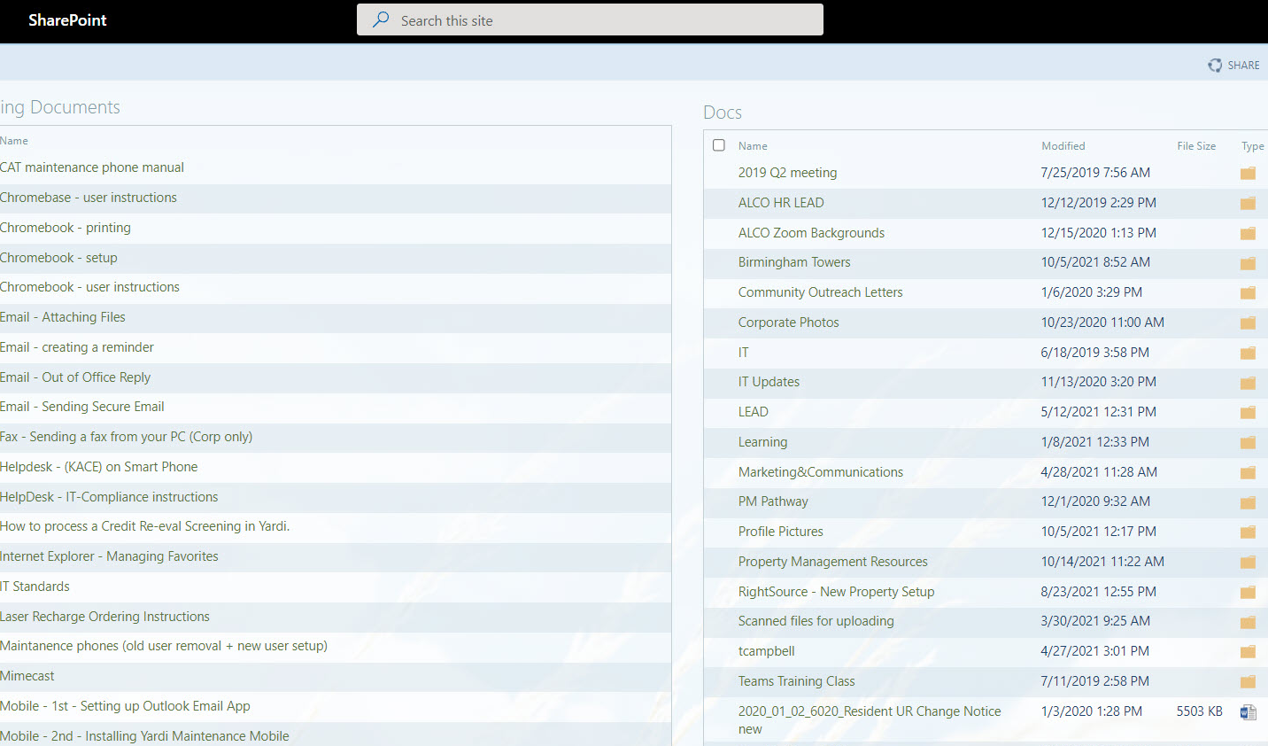
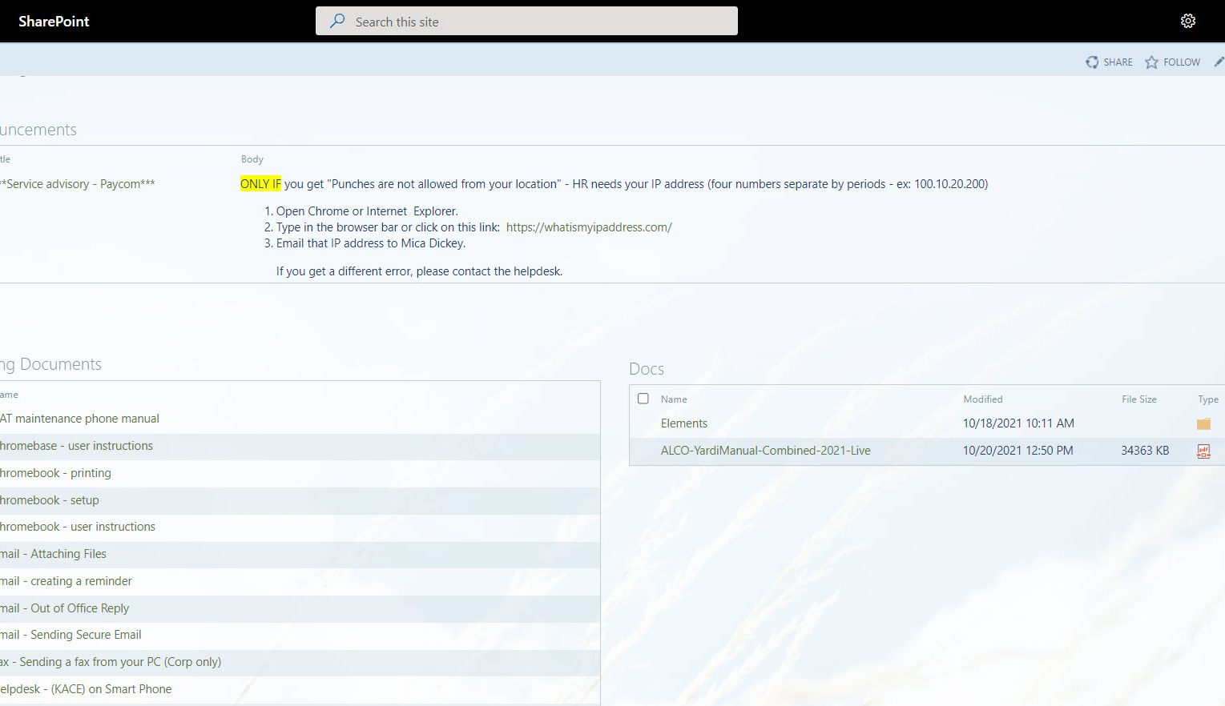
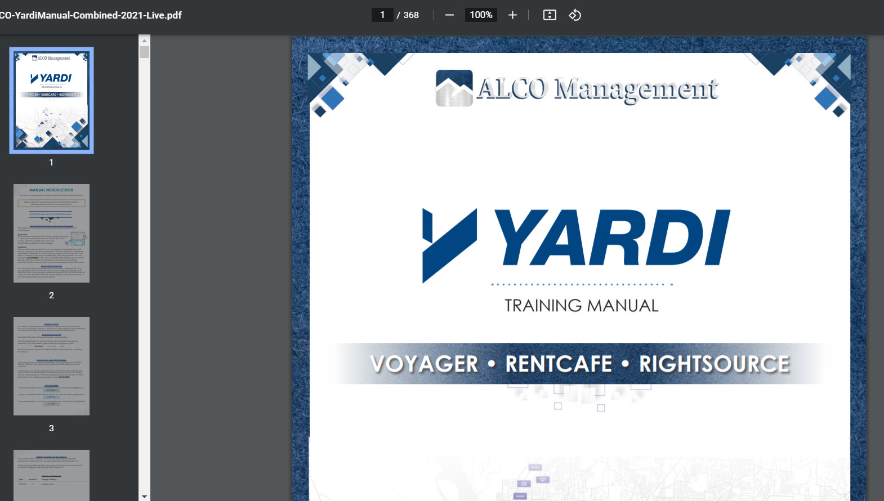
Notes:
This process is outlined in the:
Yardi Training Manual

Slide 24
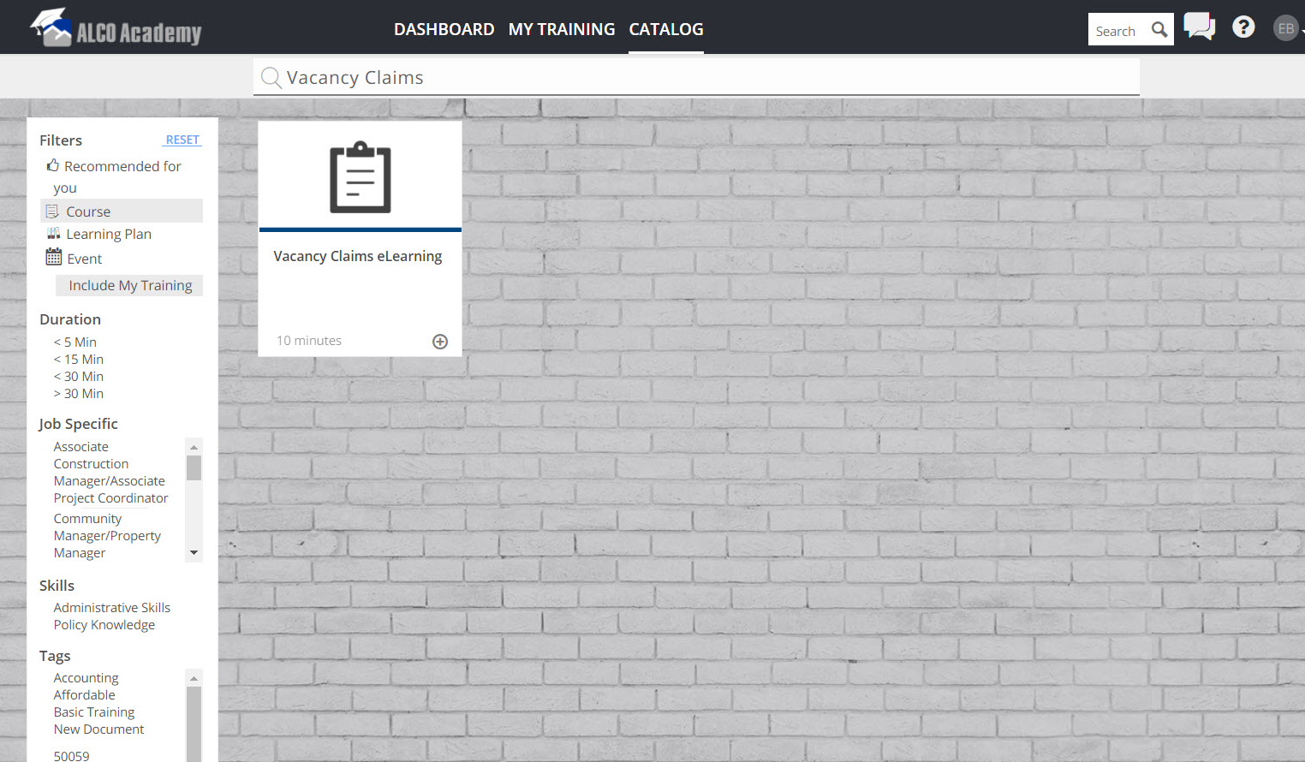
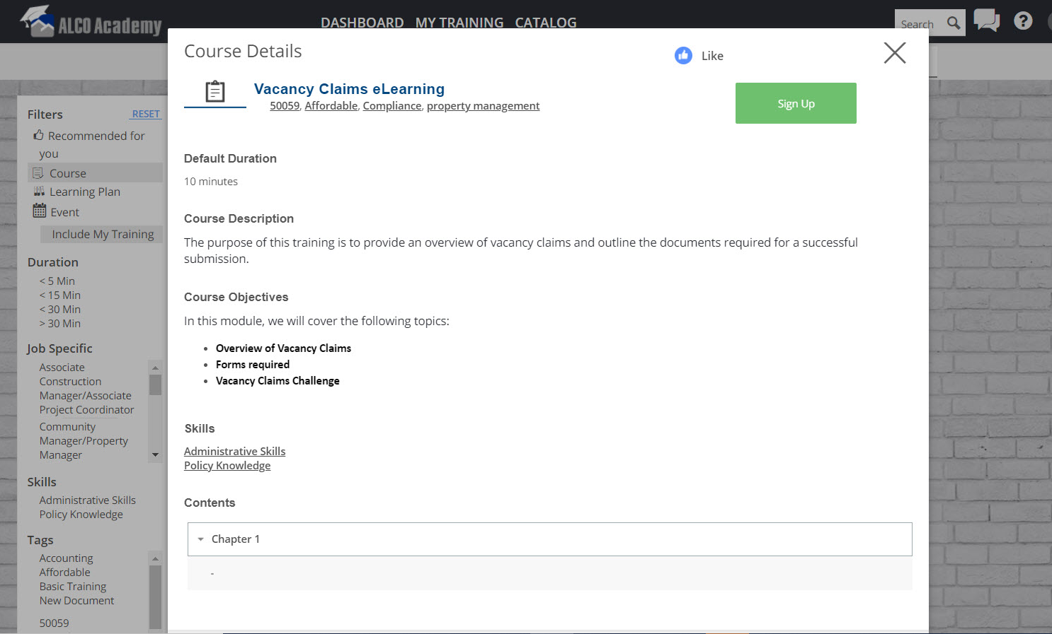
Notes:
This process is outlined in the:
RCRS Special Claims Course in ALCO Academy
We recommend that you visit any of these learning resources for a refresher on the process or when creating your first vacancy loss special claim.

Slide 25

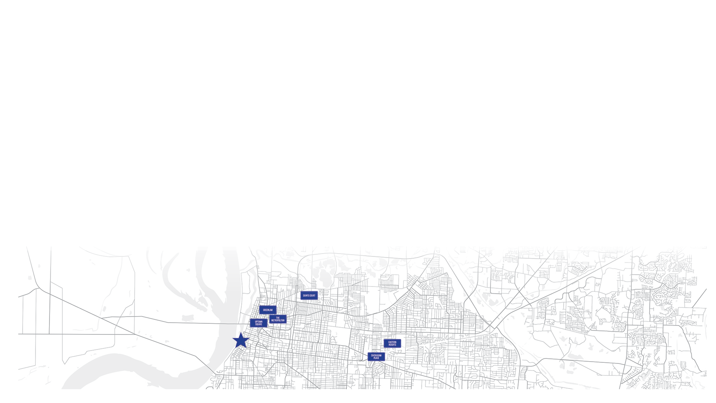


THANK YOU
Notes:
Any Questions?

